Slide 1

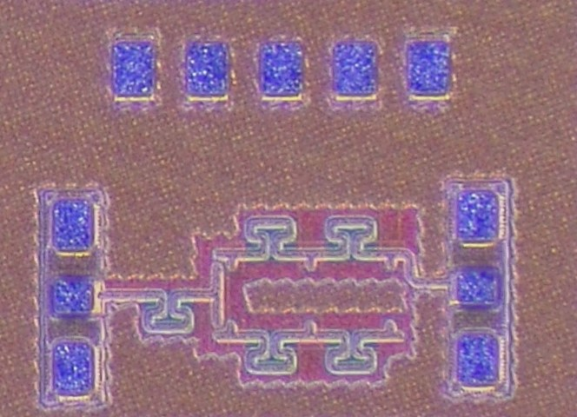
A High Isolation DC-50 GHz SPDT Switch for On-Chip Vector Network Analyzer(VNA) Implementation
Yeheon Park, Sanggeun Jeon
School of Electrical Engineering, Korea University, Seoul 136-713, Korea
Introduction
On-chip VNA with SPDT switch
  The need for on-chip VNAs to measure DUTs in a short period of time as high volume systems that require large amounts of DUT measurements increase
  From an On-Chip VNA perspective, switch is connected to an RF signal source and two refletometers
  That is why SPDT switch must have high linearity and high isolation performance
Design
By using inductors and shunt transistors, artificial transmission lines are implemented to reduce insertion loss.
By applying negative body bias technique, improved linearity and insertion loss.
As a results, high isolation performance can be achieved while maintaining low insertion loss.
Vb
Vg
Vg1
P1
P2
0.5 dB
Experimental Results
Performance | Value
3-dB BW | DC-50 GHz
Insertion loss | < -3.8 dB
Return loss | > 13 dB
Isolation | > 41 dB
IP1dB(@ 20 GHz) | 11.5 dBm
Insertion loss
Return loss
Isolation
Conclusion
Broadband CMOS SPDT switch is designed using 28-nm bulk CMOS technology.
SPDT switch shows high isolation of 41 dB or more in the operating frequency band.
The chip fabrication and EDA tool were supported by the IC Design Education Center(IDEC), Korea

